Slide 1

Minimum Register Instruction Sequence (MRIS)
By,
Vikram TV
Shashidhar G
A Rajkiran
Computer Science and Engineering,
SJCE - MYSORE.

Slide 2
Compilers

Slide 3
Compiler Phases
Front End
Lexical analysis
Syntax analysis
Semantic analysis
Intermediate Code Generation
Back End
Machine Dependent and Machine in-dependent code optimizations
Code Generation

Slide 4
SuperScalar Processor

Slide 5
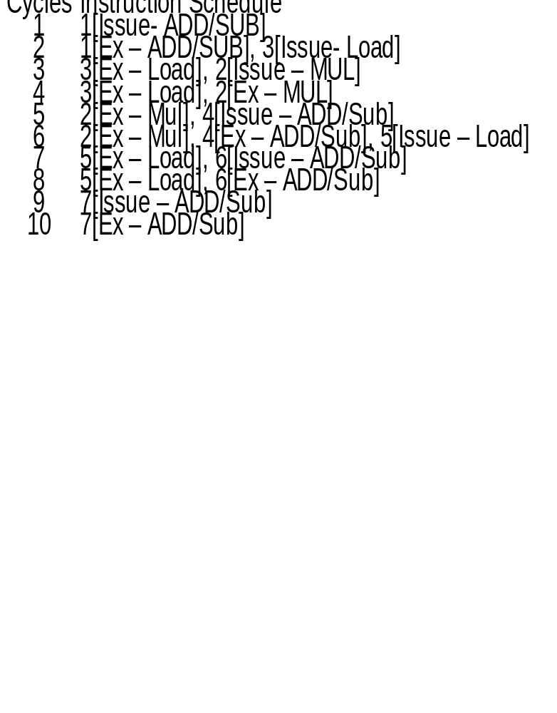
Instruction Scheduling
1: a = x +y (2)
2: b = a * c (4)
3: d = x (3)
4: c = d -5 (2)
5: e = z (3)
6: f = b + 55 (2)
7: b = e + 100(2)
1Add/Sub unit, 1 Mul unit, 1 Load/Store unit.
2 cycles for Add/Sub, 3 cycles for Load/Store, 4 cycles for Mul/Div
A normal sequential processor would take 18 cycles. But by
scheduling the instructions, the cycles has been reduced to 10.

Slide 6
Instruction Scheduling
Any Instruction sequence will have 3 types of dependences among instructions. Flow dependency(RAW), Anti Dependency(WAR) and Output Dependency(WAW).
Scheduler must take into account all these three types of dependencies for generating a schedule.
There are 2 types of Scheduling:
  Static Scheduling: done by compiler
  Dynamic Scheduling: At runtime, hardware embedded using Register Renaming.
Uses topological sorting and the data dependency information.

Slide 7
Data Dependency Graph
Represents the data flow across the program.
Nodes are the Instructions.
Directed edges indicate flow of data.

Slide 8
Register Allocation
a = x
b = a + 4
c = a * 8
x = c
d = b * c
e = d * b
If the number of avaliable registers are 2, then we need to spill some variables
After Spilling b
a = x
b = a + 4
M[b_loc] = b // Store
c = a * 8
x = c
b = M[b_loc] // Restore
d = b * c
e = d * b

Slide 9
Allocation of registers
Instruction Sequence
a = x
b = a + 4
M[b_loc] = b // Store
c = a * 8
x = c
b = M[b_loc] // Restore
d = b * c
e = d * b
Number of registers = 2
R1 = M[x]
R2 = R1 + 4
M[b_loc] = R2
R2 = R1 * 8
M[x] = R2
R1 = M[b_loc]
R2 = R1 * R2
R1 = R2 * R1

Slide 10
Scheduling vs Sequencing
Conventional scheduling – takes latency and function unit resources into account and reorders the instructions.
Spilling and register pressure
More register pressure, more spilling and therefore more execution time.
Register reduction mechanism by sequencing that uses less number of registers.

Slide 11
Scheduling vs Sequencing contd...
Reducing spill code is necessary because:
  large cache miss penalty
  from a memory bandwidth usage viewpoint
  from an instrution-level parallelism viewpoint as the elimination of some of the spill
  instructions frees instruction slots to issue other useful instructions;
  from a power dissipation viewpoint, as load and store instructions contribute to asignificant portion of the power consumed;
  in multi-threaded architectures, minimizing the number of registers in a thread reduces the cost of a thread context switch.

Slide 12
Sequencing
Uses less registers
Formation of lineages aides it.
Phase ordering
Placement of the sequencer
  Sequencer orders instructions that use less registers.
  This aides register allocator to use less registers.
  Finally, post-register allocation scheduling is performed.

Slide 13
Live range of a variable
The live range of a variable starts when the variable gets its definition and ends at the last use of that variable.
Live range of,
X = (1, 4]
Y = (3, 6]
Z = (4, ..]
1 : X = …
2 : .....
3 : Y = X + 5
4 : Z = Y – X
5 : .......
6 : .... = Y

Slide 14
Live range
The variables are mapped to physical registers.
If two or more variables are live simultaneously then each of them need separate registers.
Increase in such overlapping live ranges increases the register pressure on the program.
Spilling of some live ranges in memory which cannot be allocated a register. Load/stores
Number of spilling degrads the performance of the processor.
Hence the need to reduce the register pressure

Slide 15
An Example Instruction Sequence
A : T1 = Ld(x);
B : T2 = T1 + 4;
C : T3 = T1 * 8;
D : T4 = T1 – 4;
E : T5 = T1 / 2;
F : T6 = T2 * T3;
G : T7 = T4 – T5;
H : T8 = T6 * T7;
The number of register requirement is 4

Slide 16
Another Instruction Sequence
A : T1 = Ld(x);
D : T4 = T1 – 4;
E : T5 = T1 / 2;
G : T7 = T4 – T5;
C : T3 = T1 * 8;
B : T2 = T1 + 4;
F : T6 = T2 * T3;
H : T8 = T6 * T7;
The number of register requirement is 3

Slide 17

Lineages – An Overview
Node f uses the value produced by b. No other node does use.
Heir of the node
Register result of node b can be passed to f, to store its result. i.e Sharing of registers.
Similarly nodes e and g.

Slide 18
Lineages - Overview
Nodes f and g cannot share as they overlap
Nodes c and d overlap partially. Some ordering of insructions have to done to have both c and d share the same registers.

Slide 19
Lineages - Overview
Lineages : set of instructions that can definitely share a register.
Between the parent node and its heir.
For multiple descendants, an arbitrary heir is chosen and sequencing edges are inserted.
Sequencing edges for the totally ordering of the instructions to conform the DDG of the program

Slide 20
Lineages - Overview
Lineages
L1 = {a, b, f ,h}
L2 = {c, f}
L3 = {e, g, h}
L4 = {d, g}

Slide 21
Lineage Formation
A node can have more than one descendant, but there can be only one node that can be the heir
A heir inherits the register from the parent node, thus sharing the register and hence must it be the last use of the inherited register.
As a result it must be listed after all the sibling nodes are listed.
This introduces sequencing constraints among the descendant nodes

Slide 22
Lineage Formation
To make sure the heir is the last node to be listed, the algorithm introduces sequencing edges.
To ensure that the sequencing edges does not make the graph cyclic, the node with the samllest height is chosen to be the heir.
The height of the DDG is recomputed after introduction of every sequencing edge.
Lineages are formed by the arcs between the nodes and the chosen heirs
Only the arcs that represent data dependencies are used for lineage formation.

Slide 23
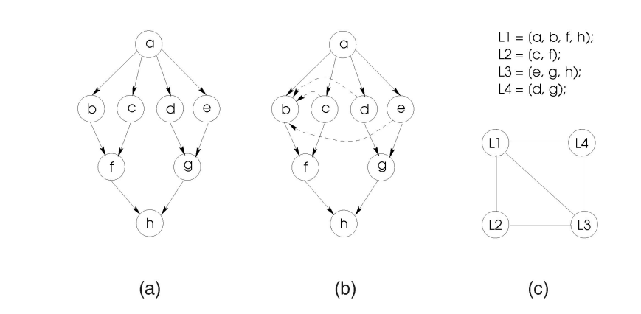
Lineage Formation

Slide 24
Lineages
Lineages are the set of nodes (instructions) in the data-dependency graph that share the same register.
t2 = t1 + 2;
t3 = t2 + 4;
t4 = t2 * 6;
t1 loaded to r1.
r1
t1 + 2 can be stored to r1 or some other register r2. But, in register re-use, it is stored to r1.
r1 stored to t2. t2 loaded to r1
Now, t2 + 4 can be stored in r1 or some other register r2. In register re-use, t2 + 4 is stored in r1. Thus, r1 is passed from instruction 1 to instruction 2.
r2
If no memory operation is done to increase execution time, t2 should remain in r1.
Then t2 + 4 or t3 should be stored in new register r2. The final result t2 * 6 can be stored in r1 or r2 depending on the case. r1 and r2 overlap between instructions 2 and 3.
* DDG during implementation.

Slide 25
Lineages – Lu and Lv
We are not sure if we can use both Rx and Ry with the same register.
v1
u1
Lv
Lu
Uses register Ry
Uses register Rx
um
vn

Slide 26
Optimizations on Lineages
It is possible that two or more lineages can share the same register (i.e. Rx = Ry), if the live ranges of the lineages do not overlap (as r1 and r2 was used previously)
We check this possibility using the reach relation.
Reach relation: If the start of a lineage, say u1 of Lu, can reach the end of a lineage, say vn of Lv, then
R(u1, vn) = 1
R(u1, vn) = 0 otherwise
v1
u1
Lv
Lu
um
vn

Slide 27
Optimizations on Lineages
If S is the set of start nodes of lineages and E is the set of end nodes, the reach relation R: S → E maps S to E. For all a ∈ S and b ∈ E, node a reaches node b , R(a , b ) = 1, if there is a path in the augmented DDG from a to b .Otherwise, R(a , b ) = 0
Reach is calculated across sequencing edges too.
Thus a Reach Matrix is calculated.

Slide 28
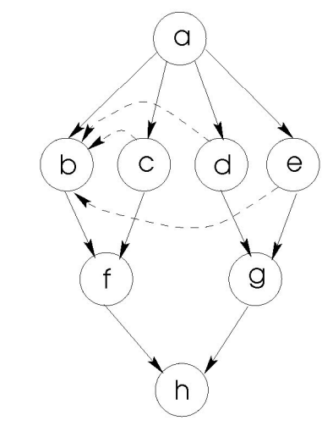
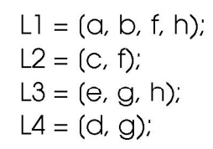
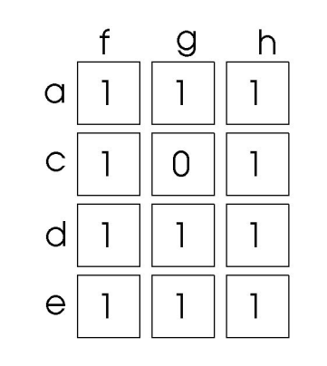

Slide 29
Optimizations on Lineages
v1
What to do with Reach Matrix?
Lu and Lv are lineages. The live range of Lu and Lv definitely overlap if u1 reaches vn and v1 reaches um.
Definite overlap happens only when R(u1, vn) = 1 and
R(v1, um) = 1
When there is an overlap, the same register (Rx = Ry) cannot be used. The two lineages require two separate registers.
u1
Lv
Lu
um
vn

Slide 30
Optimizations on Lineages
Thus, two lineages do not overlap when
  R(u1, vn) = 1 and R(v1, um) = 0
  R(u1, vn) = 0 and R(v1, um) = 1
  R(u1, vn) = 0 and R(v1, um) = 0
That is, we can reuse the register and order the lineages one after the other.
This ordering is done by Lineage Fusion.

Slide 31
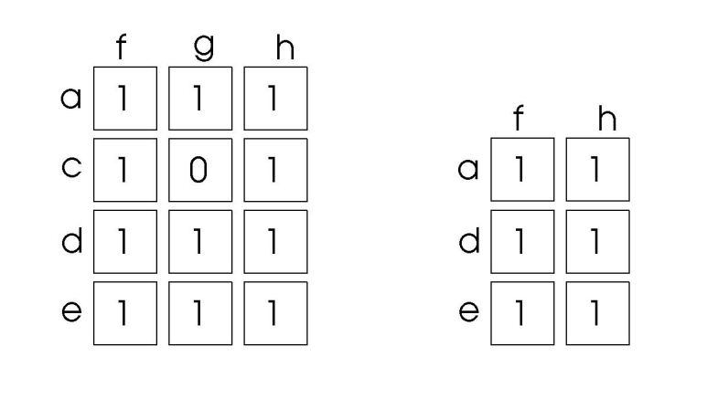
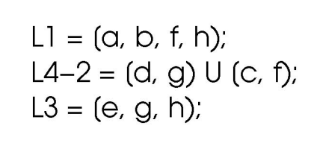
Optimizations on Lineages: Lineage Fusion
We identify 0's in the Reach Matrix and fuse them.
Lineage Fusion is performed until there are no more 0's in the Reach Matrix.

Slide 32
Optimizations on Lineages: Lineage Fusion
A sequencing edge from um to v1 is inserted in the DDG. The lineages Lu and Lv are removed and a new lineage Lw = [u1 , u2 , ...., um ) ∪ [v1 , v2 , ...., vn ) is inserted in the lineage set.
If we add Lv after Lu then this constraint is reflected by adding a sequencing edge from Lu to Lv.
Thus, the height of nodes in Lu is greater than that in Lv and the nodes in Lu can use the register and pass it onto nodes in Lv.
When R(u1, vn) = 0 and R(v1, um) = 0, we do not fuse the two lineages. Because this would unnecessarily add a constraint in the order of Lu and Lv.

Slide 33
Optimizations on Lineages: Lineage Interference Graph
Till now we tried to reduce the number of registers but we do not know how many registers are needed.
LIG is used to determine the number of registers needed. This is done by graph coloring the LIG.
Each lineage is represented by a node in LIG.
LIG contains an arc between two nodes if and only if the live ranges of lineages represented by the nodes overlap in all possible instruction sequences i.e. there is an edge in LIG when
  R(u1, vn) = 1 and R(v1, um) = 1

Slide 34
Coloring
LIG is then colored using heuristic graph coloring algorithm [Chaitin]. Coloring refers to assigning virtual registers to the nodes(instructions).
The physical registers are allocated later using traditional register allocation methods (like linear scan).
The number of colors required to color the interference graph is referred to as the Heuristic Register Bound (HRB).
HRB computed is near-optimal solution and graph coloring generally is NP-complete.
Thus, the idea was to generate reach matrix, use it to fuse lineages. The LIG is constructed on fused lineages and colored.

Slide 35
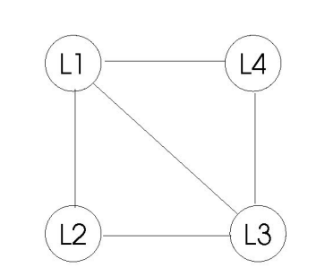
Lineage Interference Graph (LIG): Before Fusion
  R(u1, vn) = 1 and R(v1, um) = 1

Slide 36
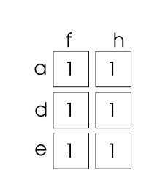
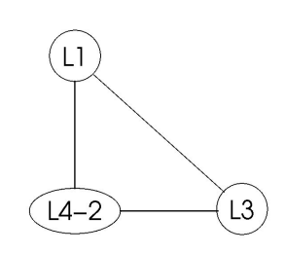
Lineage Interference Graph (LIG): After Fusion

Slide 37
Instruction Sequence
The Sequencing algorithm uses the information obtained from the coloring of the LIG, and lists the nodes from a ready list based on the height priority and availability of registers assigned to them.
Whenever the dependencies of a node are satisfied, the node is listed. Otherwise the listing of the node is postponed.
The dependencies are:
  All nodes to which this node is dependant should be already listed. This can be deduced optimally by selecting the node with greatest height.
  The register assigned to the node should be available.

Slide 38
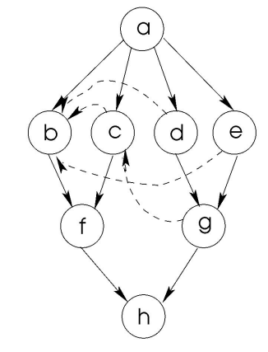
Instruction Sequence
The sequence generated is: a, e, d, g, c, b, f, h

Slide 39
Instruction Sequence: Deadlock conditions
The algorithm may result in a deadlock due to two reasons:
  First, the order of listing of nodes belonging to two different lineages having the same color assigned may result in deadlock – avoidable deadlock. This can be overcome by applying Lineage Fusion
  Second, due to the underestimation of HRB – unavoidable deadlock. This can be avoided by increasing the HRB by one cautiously.

Slide 40
Implementation
Implemented in the Low-Level Virtual Machine (LLVM) Compiler Infrastructure.
LLVM-GCC is a C front-end. It converts the source code into object code.
Pass manager and Analysis Usage.
Any compilation stage can be removed/replaced and the changes in compilaton can be seen. Easy to analyse the compilation effects.

Slide 41
SelectionDAG
LLVM maintains the DAG in a data structure known as the SelectionDAG.
Each of the nodes in the SelectionDAG is represented by the SDNode class.
class SDNode {
private:
int NodeType, NodeId, Height;
List OperandList, ValueList, UseList, Descendants;
.
.
bool IsInLineage, IsScheduled, VisitedHeight;
SDNode *SequencingEdge;
};

Slide 42
ScheduleDAG
The ScheduleDAG class contains the set of Scheduling Units, SUnits, which wrap around the SDNode. Sunit is as:
class SUnit {
private:
SDNode *Node;
MachineInstr *Instr;
DependencyList Preds, Succs;
unsigned short Latency, Height, Depth;
bool isScheduled;
.
.
};

Slide 43
Lineage.h & MRIS placement
class Lineage {
private:
List LineageNodes(pair<SUnit*, Register>);
SUnit *Start, *End;
.
.
};
Finally, the entire MRIS is implemented just before list scheduling.

Slide 44
Compilation and Usage
LLVM uses C/C++ libraries alongwith GCC/G++ and other tools like ocaml, gv/dot for its compilation.
LLVM-GCC
LLC
LLI
LLVM-PROF
LLVM-AS, LLVM-DIS, LLVM-LINK
Finally, the entire MRIS is implemented just before list scheduling.

Slide 45
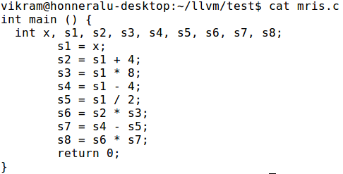
Test Cases

Slide 46
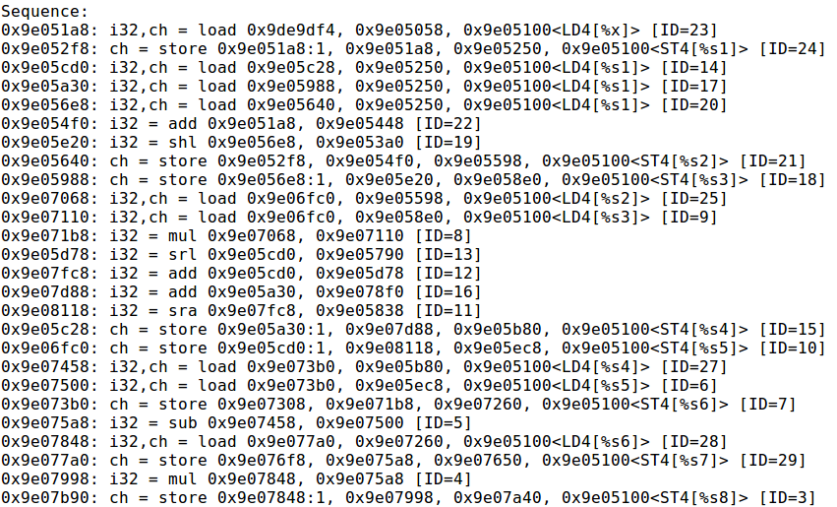
Test Cases

Slide 47
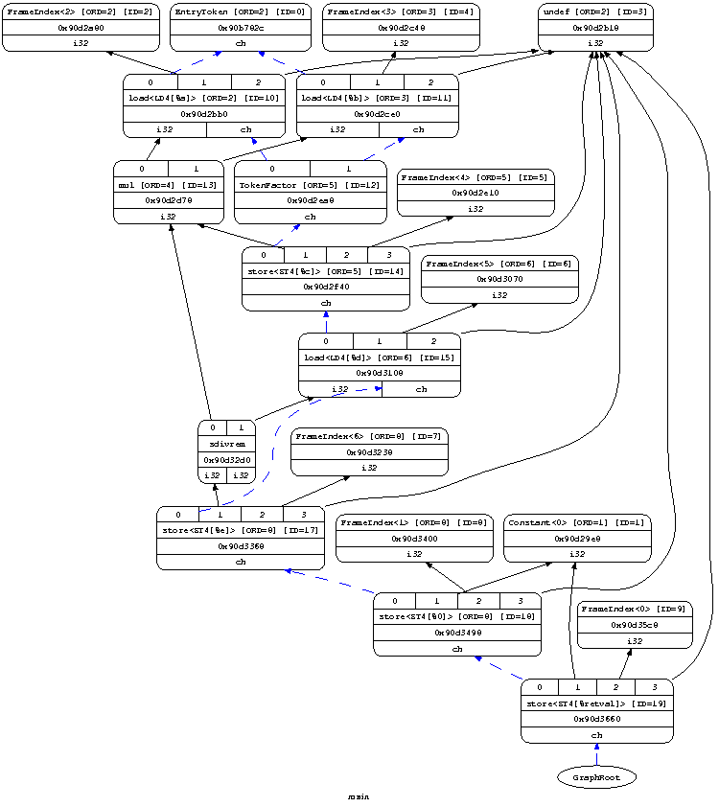
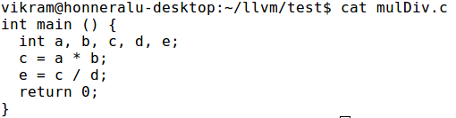
Test Cases - 2

Slide 48

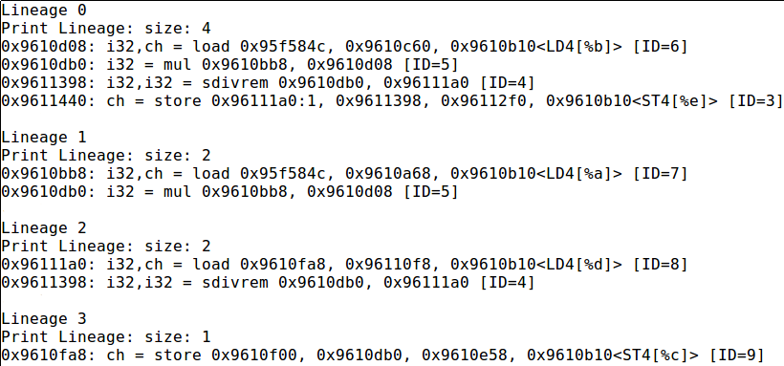
Test Cases - 2

Slide 49
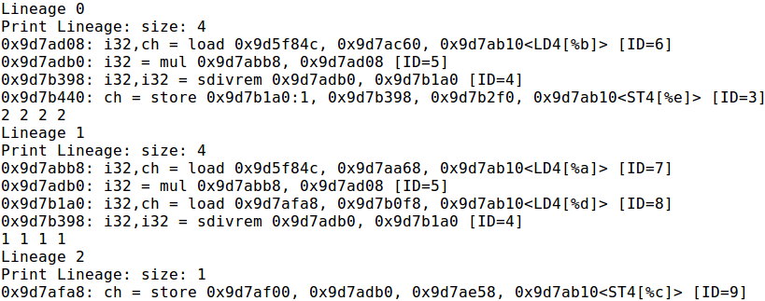
Test Cases - 2

Slide 50
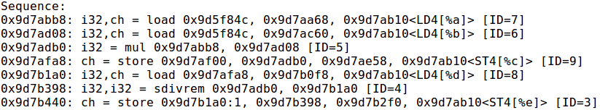
Test Cases - 2

Slide 51
Applications
• The Minimum Register Instruction Sequence can be used as an alternative to traditional scheduling in the backend of the compiler. Thus the MRIS can be implemented in all commercial compilers.
• The MRIS uses less registers during execution reducing the spill code when compared to traditional scheduling. Reduced spilling decreases memory transfers. Thus, an application compiled using the MRIS is likely to consume less power.

Slide 52
Conclusions
Traditional scheduler takes latency and function unit resources into consideration and reorders the instructions. This may lead to spilling and increases execution time.
The MRIS approach tries to minimize the number of registers by forming lineages. This approach has less spilling and therefore execution time should improve.

Slide 53
Future Work
We try to benchmark the implementation and view the exact results.
Less spilling causes less memory usage. MRIS approach may allow smaller cache. We try to test to enhance this approach and benchmark it.

Slide 54
Questions ?

Slide 55
References
Research paper on Minimum Register Instruction Sequencing to Reduce Register Spills in Out-Of-Order Issue Superscalar Architectures by R. Govindarajan et al.
Compilers – Principles, Techniques and Tools, Second Edition by Aho, Lam, Sethi, Ullman.
Modern Compiler Implementation in C by Andrew Appel.

Slide 56
Thank You
Cheers!

